Slide 1
Itunes Apple Music Store Analysis

Slide 2
Problem Statement
Apple iTunes maintains a large digital music store with millions of tracks, thousands of customers worldwide, and a network of employees managing sales operations.
As the business expands, the leadership team is looking to gain deeper insights into customer behavior, music preferences, and overall sales performance.
Our analysis is to build a complete SQL-based analytical pipeline using the available datasets, which include details about customers, employees, invoices, tracks, albums, artists, genres, playlists, and media types

Slide 4
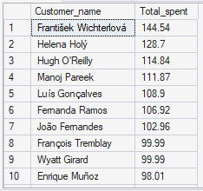
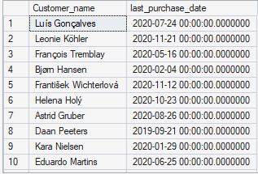
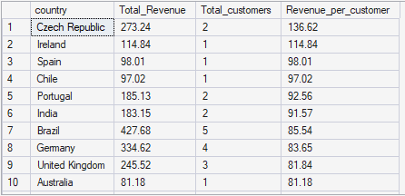


1. Customer Analytics
Which customers have spent the most money on music?
What is the average customer lifetime value?
How many customers have made repeat purchases versus one-time purchases?
Which country generates the most revenue per customer?
Which customers haven't made a purchase in the last 6 months?

Slide 5
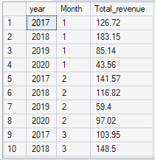


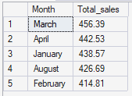
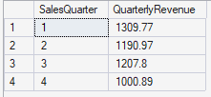
2. Sales & Revenue Analysis
What are the monthly revenue trends for the last two years?
What is the average value of an invoice (purchase)?
How much revenue does each sales representative contribute?
Which months or quarters have peak music sales?

Slide 6
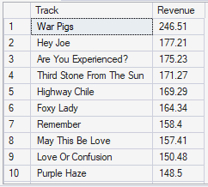
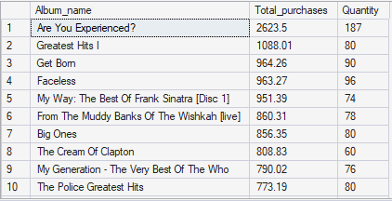
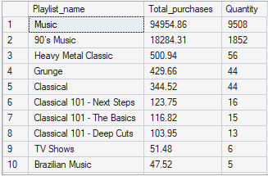
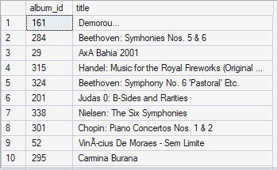
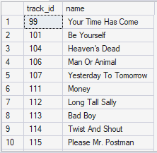

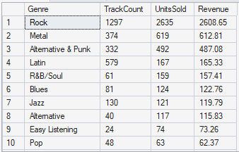
3. Product & Content Analysis
Which tracks generated the most revenue?
Which albums or playlists are most frequently included in purchases?
Are there any tracks or albums that have never been purchased?
What is the average price per track across different genres?
How many tracks does the store have per genre and how does it correlate with sales?
There are 96 albums which were never purchased
There are 1697 tracks which were never purchased
There are 25 genres

Slide 7
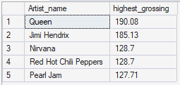
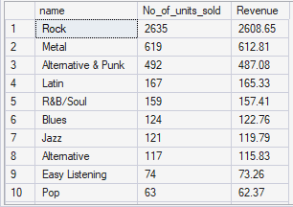
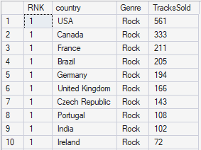
4. Artist & Genre Performance
Who are the top 5 highest-grossing artists?
Which music genres are most popular in terms of:
Number of tracks sold
Total revenue
Are certain genres more popular in specific countries?
There are 25 genres totally but where sales happened are only 18 . Remaining 7 genres have no sales
There are 24 countries totally where Rock genre is in top 1 except for Argentina where Alternative & Punk is in top 1

Slide 8


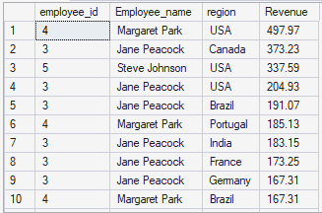
5. Employee & Operational Efficiency
Which employees (support representatives) are managing the highest-spending customers?
What is the average number of customers per employee?
Which employee regions bring in the most revenue?
Based on top 10 spending customers

Slide 9
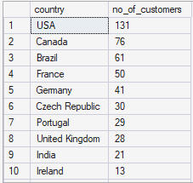
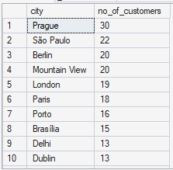
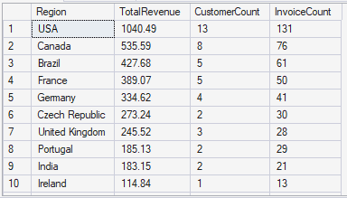
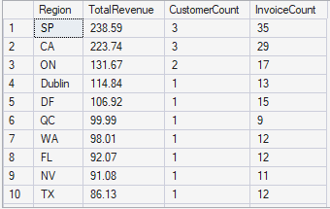
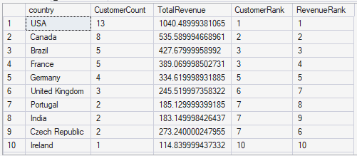
6. Geographic Trends
Which countries or cities have the highest number of customers?
How does revenue vary by region?
Are there any underserved geographic regions (high users, low sales)?

Slide 10
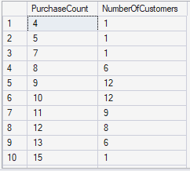

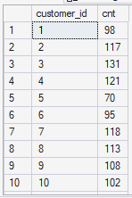


7. Customer Retention & Purchase Patterns
What is the distribution of purchase frequency per customer?
How long is the average time between customer purchases?
What percentage of customers purchase tracks from more than one genre?

Slide 11
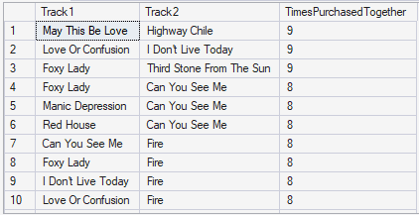
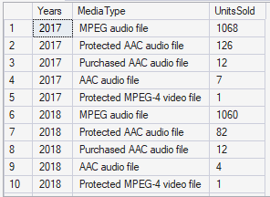

8. Operational Optimization
What are the most common combinations of tracks purchased together?
Are there pricing patterns that lead to higher or lower sales?
Which media types (e.g., MPEG, AAC) are declining or increasing in usage?
The total Media type drastically reduced to 1234 in 2019 to 1150 in 2020 which is low in the total 4 years data provided

Slide 12
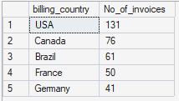



-- Q1. Who is the senior most employee based on job title?
-- Q2. Which countries have the most Invoices?
-- Q3. What are top 3 values of total invoice?
-- Q4. Which city has the best customers? We would like to throw a promotional Music Festival in the city we made the most money.
-- Write a query that returns one city that has the highest sum of invoice totals. Return both the city name & sum of all invoice totals.
-- Q5. Who is the best customer? The customer who has spent the most money will be declared the best customer.

Slide 13
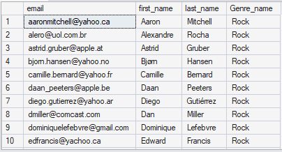
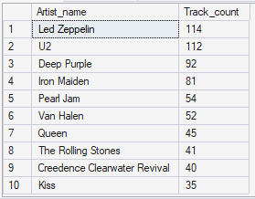
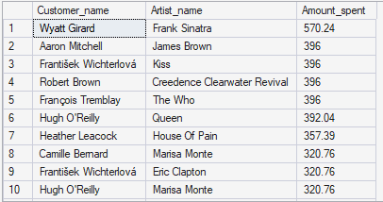
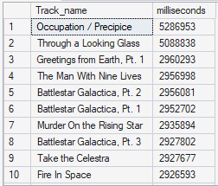
-- Q6. Write a query to return the email, first name, last name, & Genre of all Rock Music listeners. Return your list ordered alphabetically by email starting with A
-- Q7. Let's invite the artists who have written the most rock music in our dataset.
-- Write a query that returns the Artist name and total track count of the top 10 rock bands.
-- Q8. Return all the track names that have a song length longer than the average song length.
-- Return the Name and Milliseconds for each track. Order by the song length with the longest songs listed first.
-- Q9. Find how much amount spent by each customer on artists. Write a query to return the customer name, artist name, and total spent.
Totally we have 59 customers
Totally we have 494 songs where song length > avg song length

Slide 14
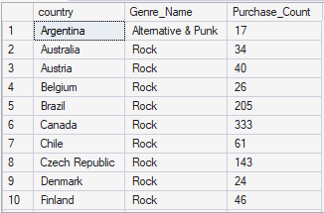
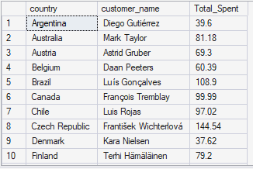
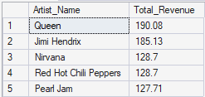
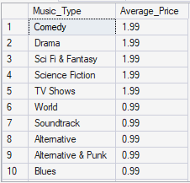
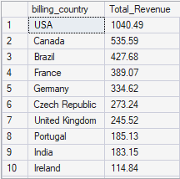

-- Q10. We want to find out the most popular music Genre for each country.
-- We determine the most popular genre as the genre with the highest amount of purchases.
-- Write a query that returns each country along with the top Genre. For countries where the maximum number of purchases is shared (tie) return all Genres. -- Q11. Write a query that determines the customer that has spent the most on music for each country. Write a query that returns the country along with the top customer and how much they spent. For countries where the top amount spent is shared, provide all customers who spent this amount. -- Q12. Who are the most popular artists? -- Q13. Which is the most popular song? -- Q14. What are the average prices of different types of music? -- Q15. What are the most popular countries for music purchases?
There are 25 Types

Slide 15
Final Conclusion
Overall Insights
Most of the revenue comes from a few key countries, showing strong performance in specific markets.
A small group of customers contributes a large portion of total sales.
Certain artists generate significantly higher revenue compared to others.
Popular genres account for the majority of track purchases.
Sales remain steady overall, with some noticeable peak periods during the year.
Business improvement
Reward loyal customers with discounts, loyalty programs, or exclusive offers to increase repeat purchases.
Promote top-performing artists and genres through featured playlists, homepage highlights, and targeted marketing campaigns.
Expand marketing in high-potential countries to grow sales in underperforming regions.
Introduce seasonal promotions during peak buying periods to maximize revenue.
Use personalized recommendations based on customer purchase history to encourage upselling and cross-selling.

